Slide 1

WAY TO ENTERPRISE
AWS
VTI ACADEMY
Author: duy.nguyenngoc1@vti.com.vn

Slide 2
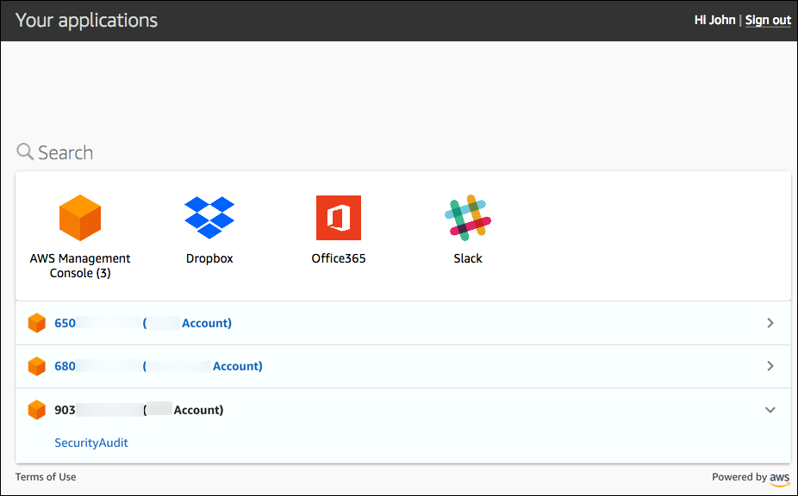
Single Sign-On Service
A service that allows centrally manage Single Sign-On to access multiple AWS Accounts and 3rd-party applications
Just login once to SSO and you can open & use for many different applications
Applications can be AWS service, 3rd-party business applications: Dropbox, G-Suite, custom SAML Application

Slide 3
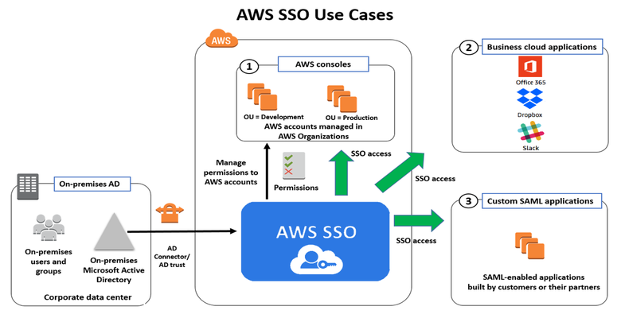
Single Sign-On Service
Integrated with AWS Organizations, on-premises Active Directory
Centralized permission management, auditing with CloudTrail
Global Service
Price: Free
Tutorial: https://docs.aws.amazon.com/ram/latest/userguide/what-is.html

Slide 4
Single Sign-On Service
Demo
Enable SSO
Create SSO User
Add AWS Account to SSO User
Test
Add Dropbox to SSO User
Test

Slide 5
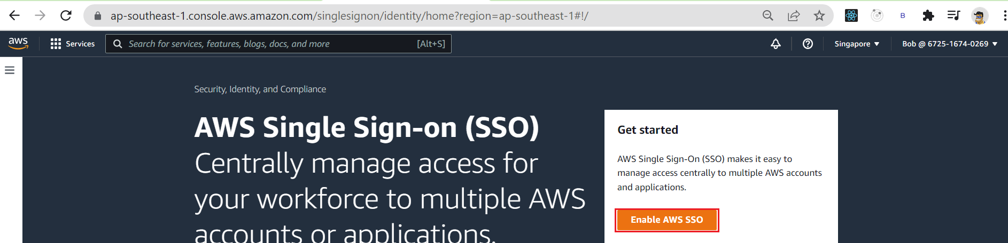
Single Sign-On Service
Enable SSO

Slide 6
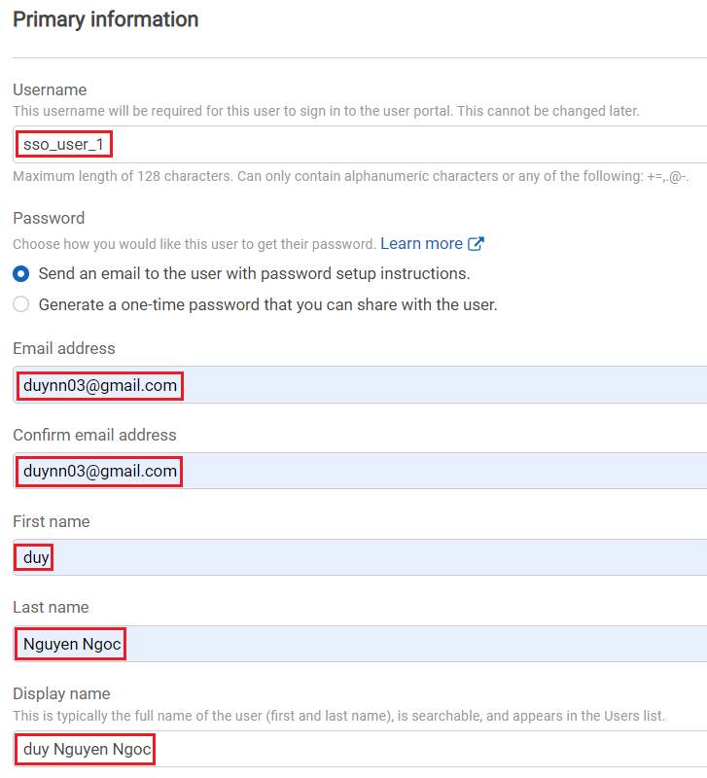
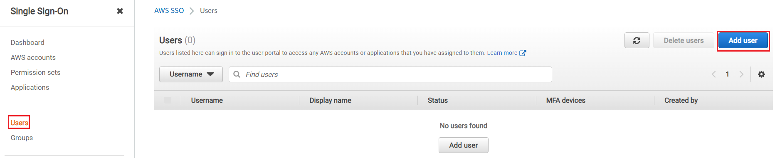
Single Sign-On Service
Create SSO User

Slide 7
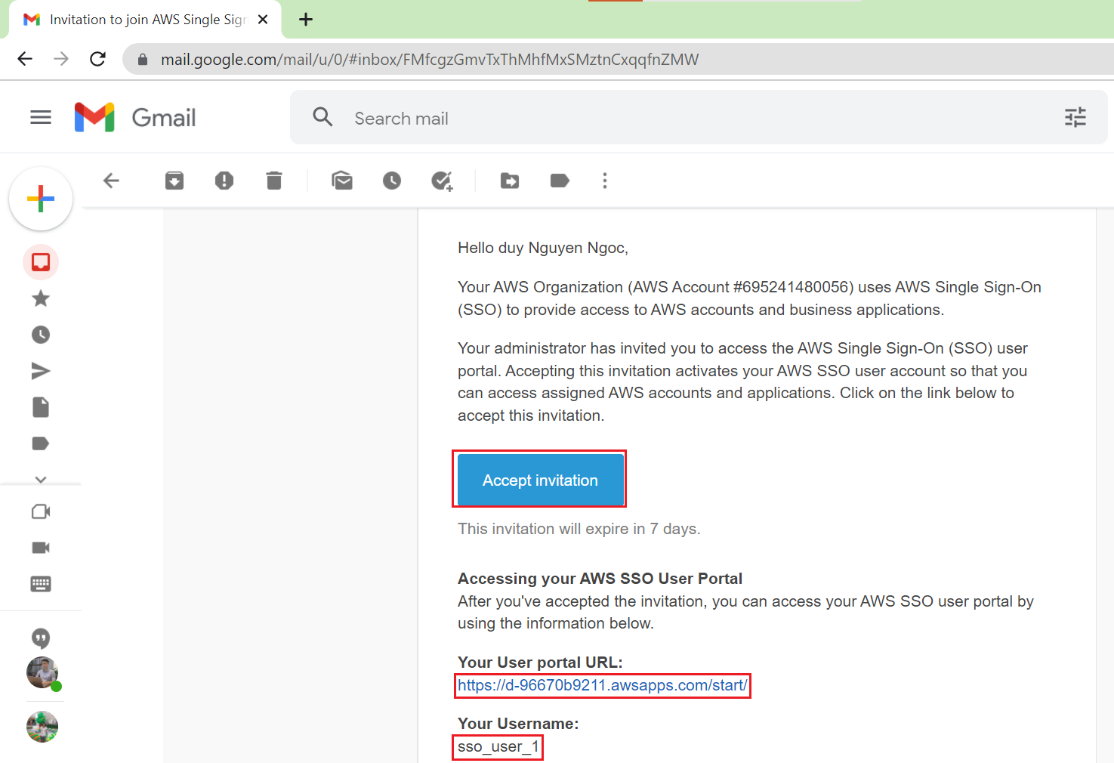
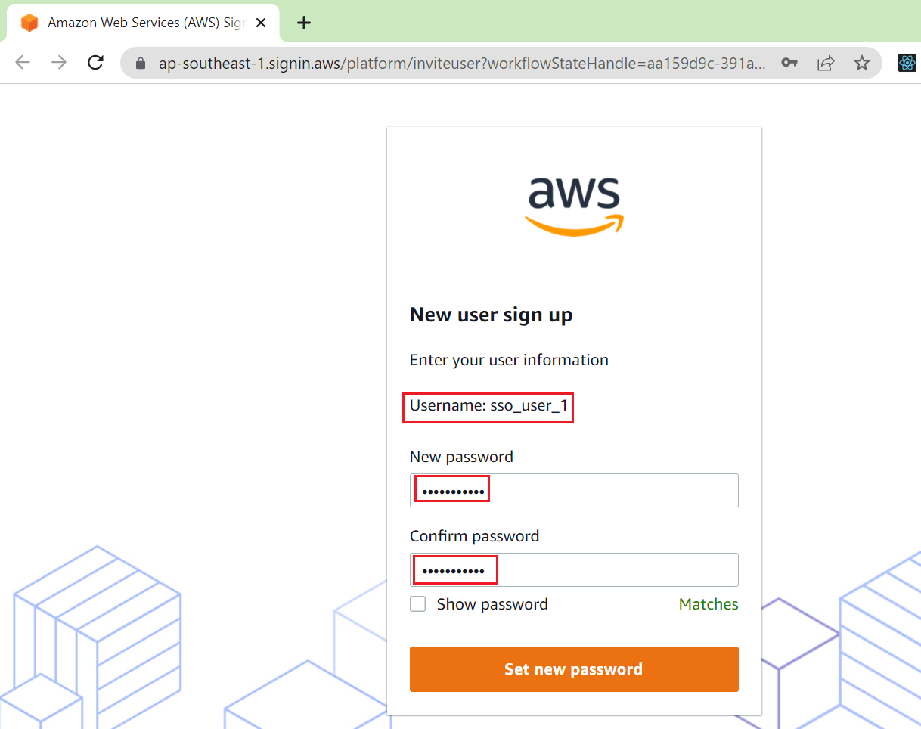
Single Sign-On Service

Slide 8
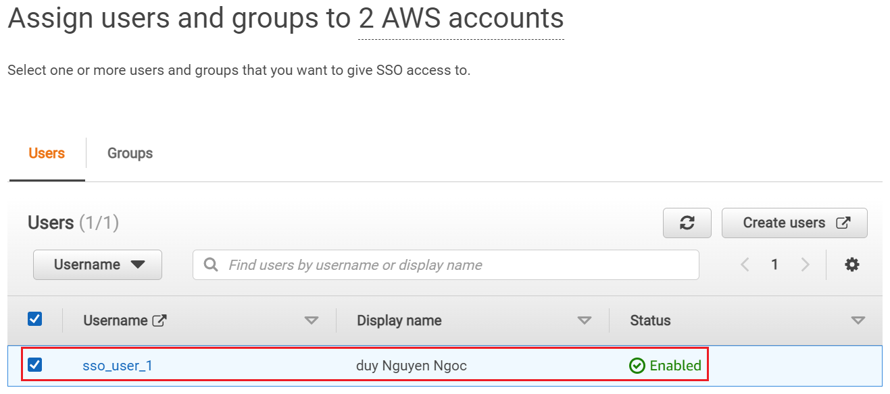
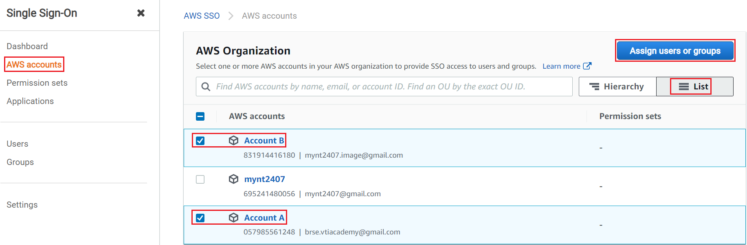
Single Sign-On Service
Add AWS Account to SSO User

Slide 9
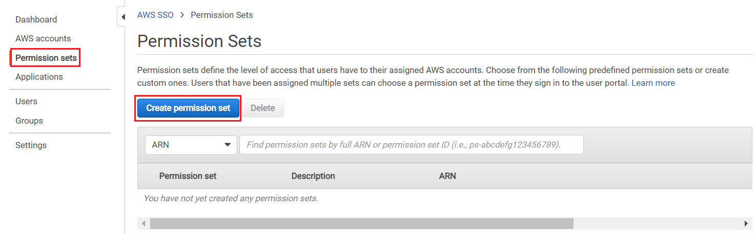
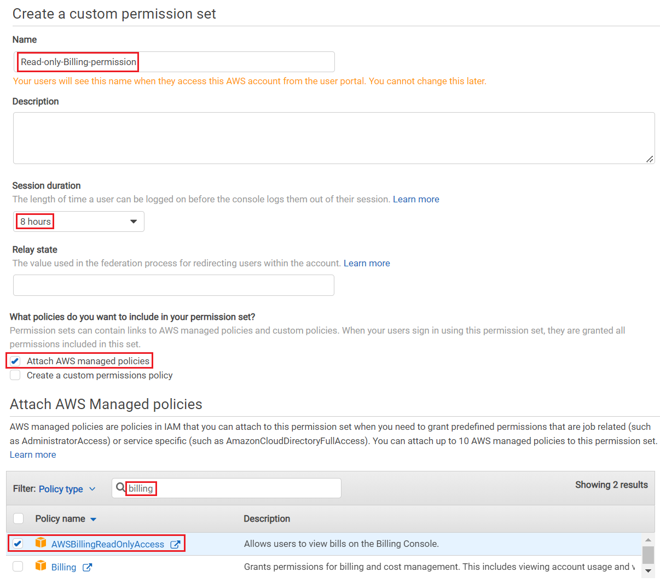
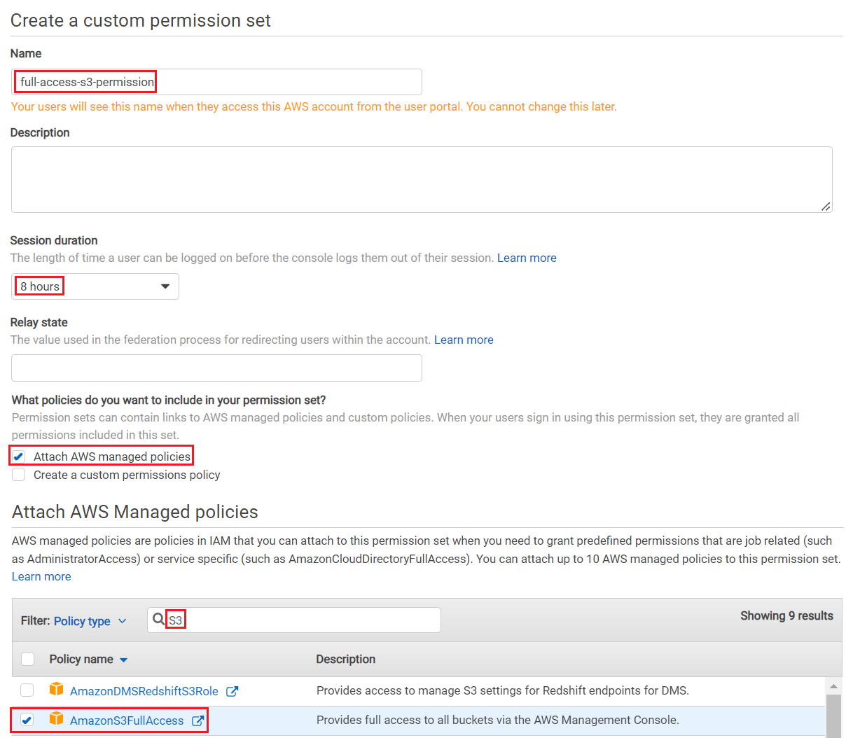
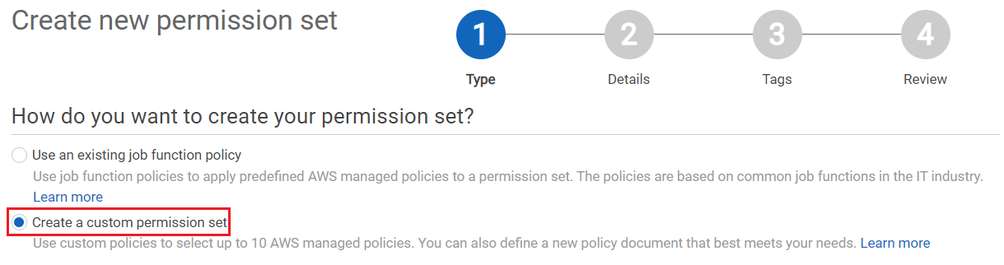
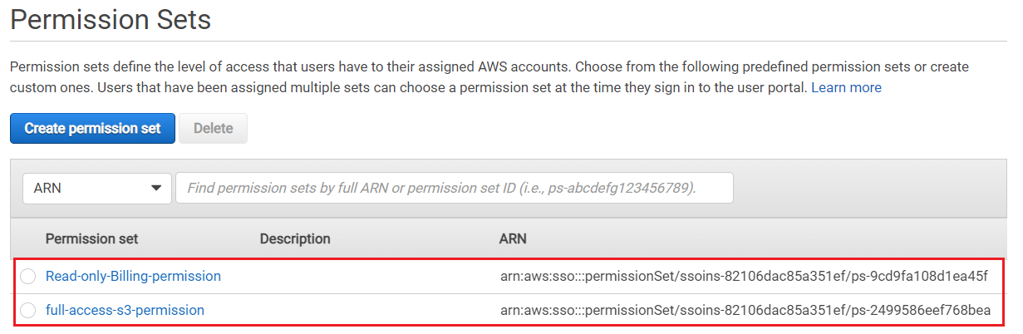
Single Sign-On Service
Create Permission

Slide 10
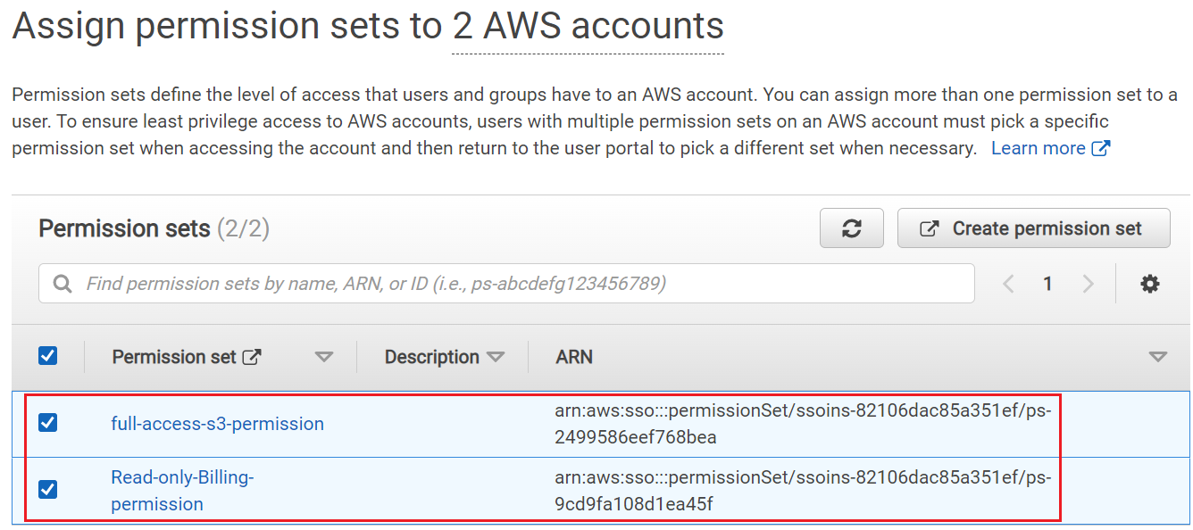
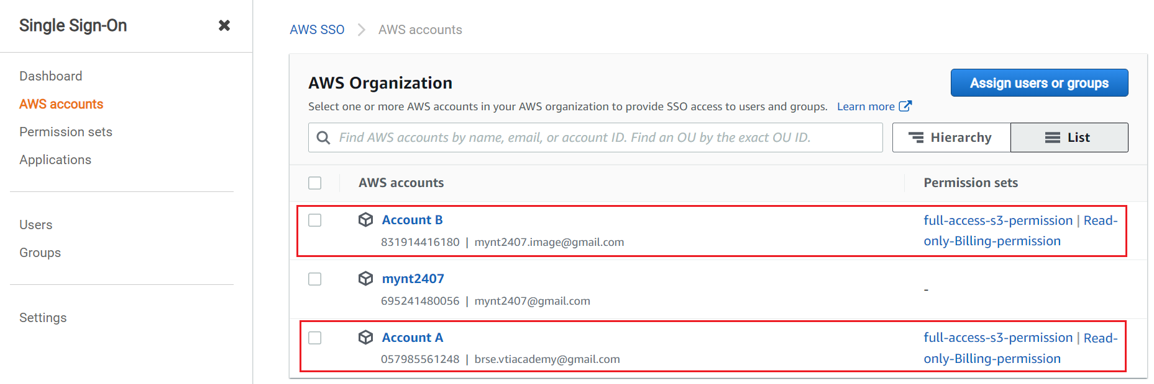
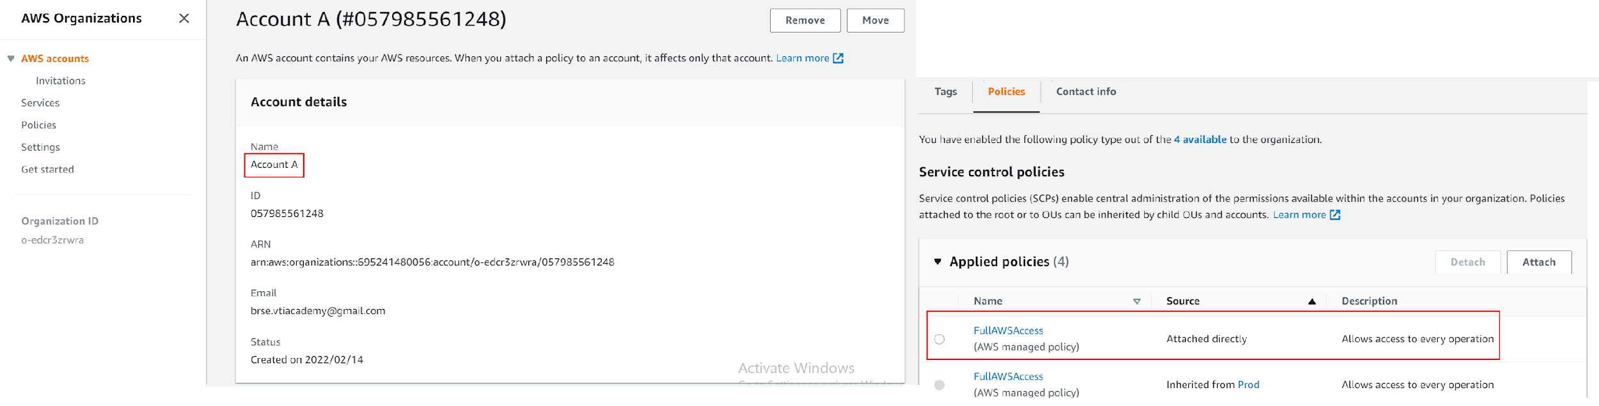
Single Sign-On Service
Add Permission to SSO User
Make sure Account A & Account B have full access s3 permission & read-only-billing-permission

Slide 11
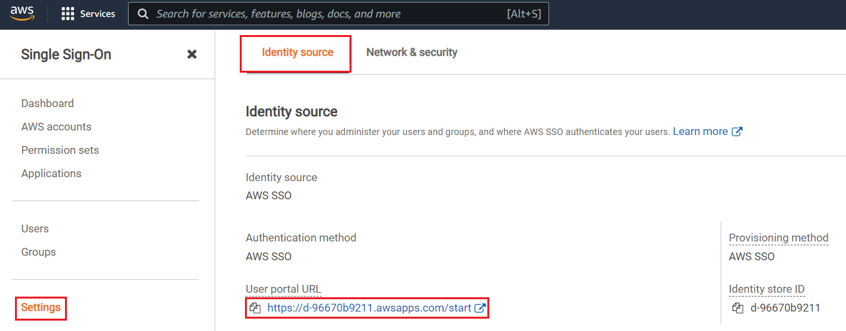
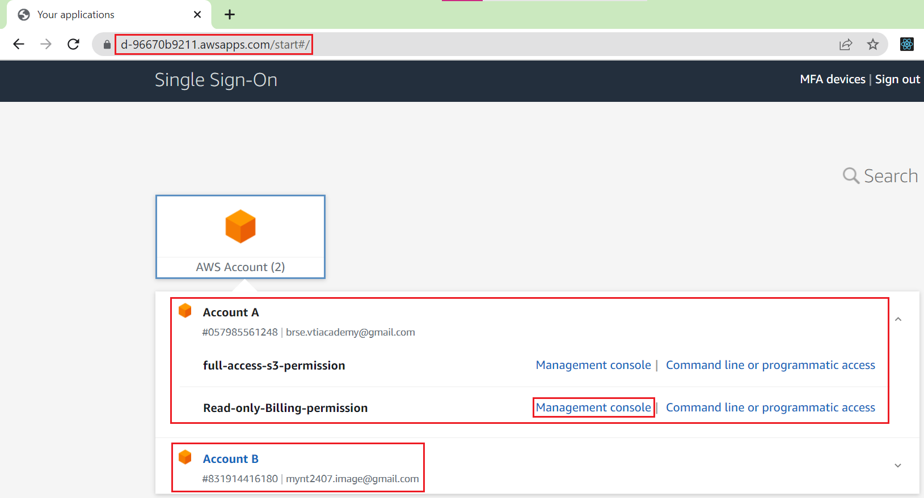
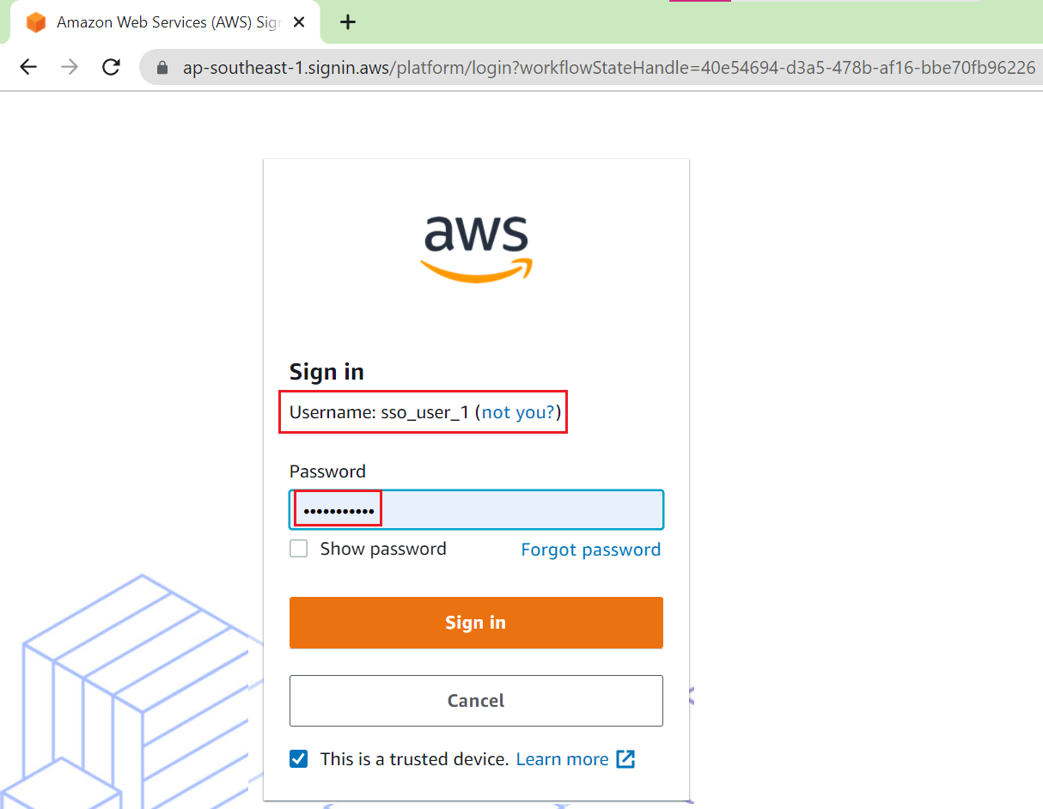
Single Sign-On Service
Test

Slide 12
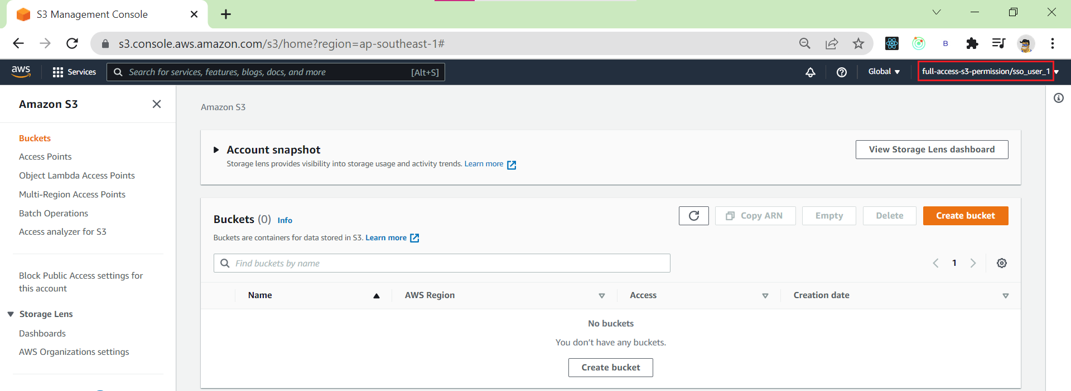
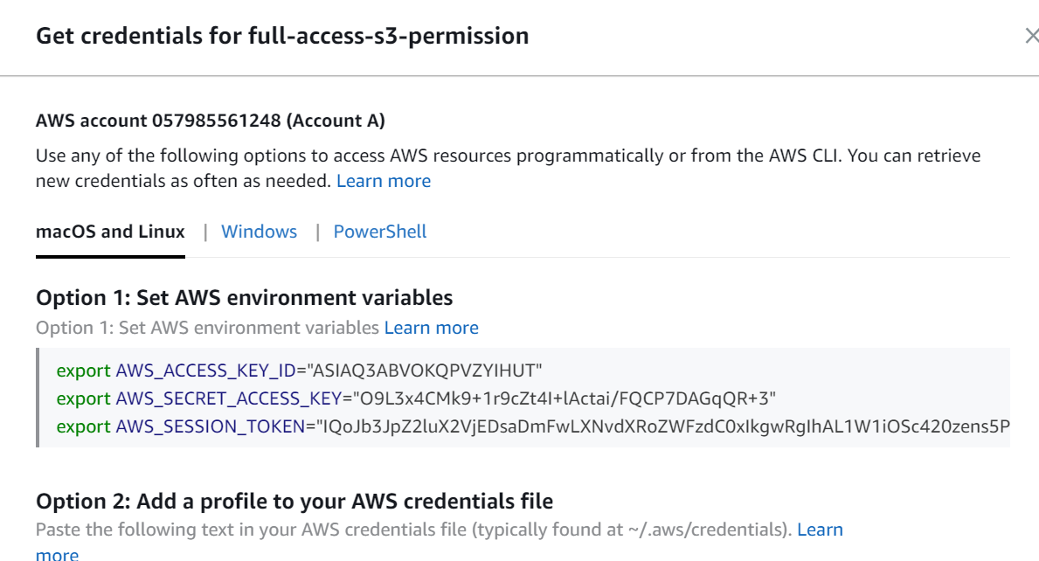
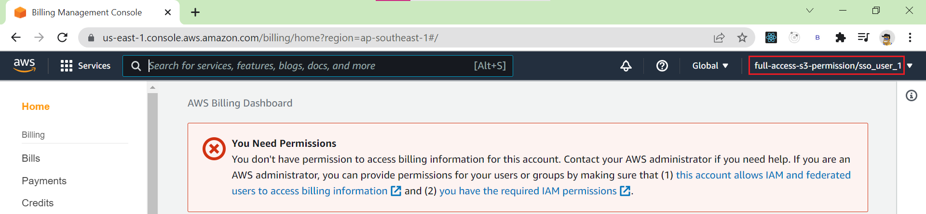
Single Sign-On Service
Login into CLI & SDK
Login into Console

Slide 13
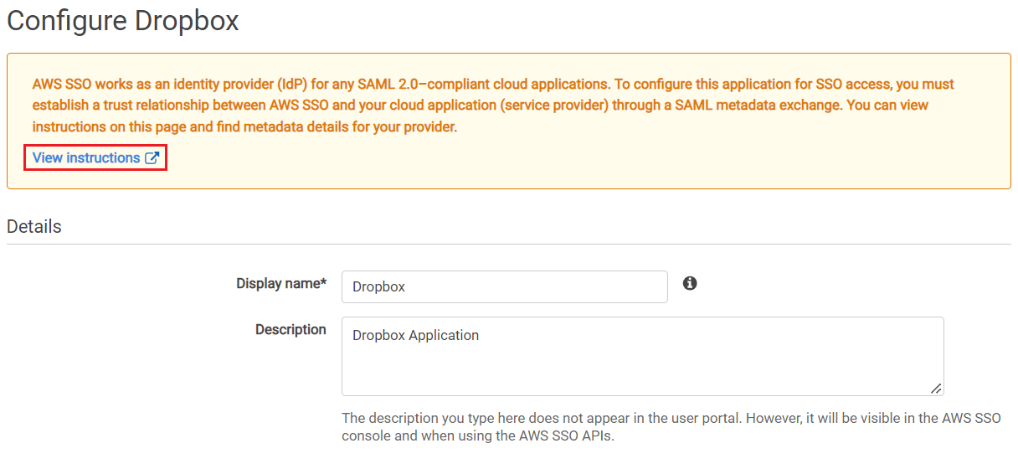
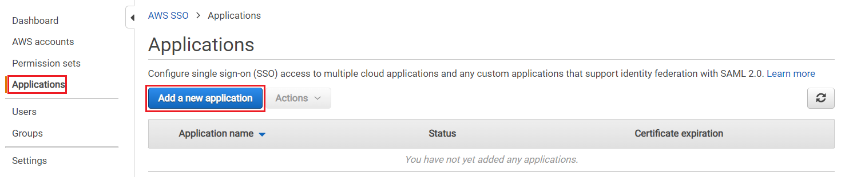
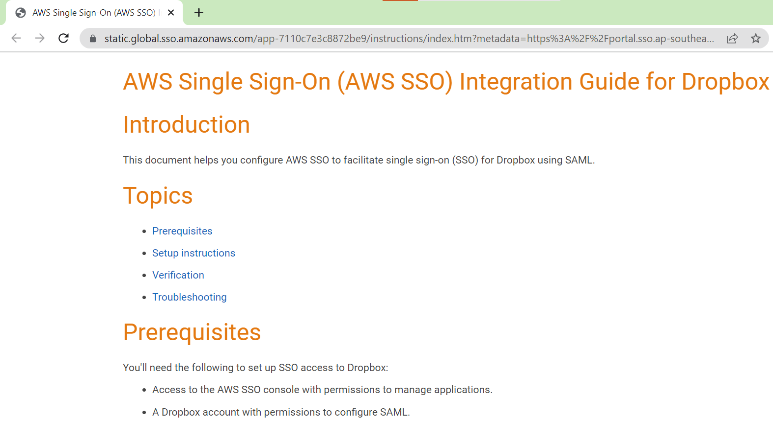
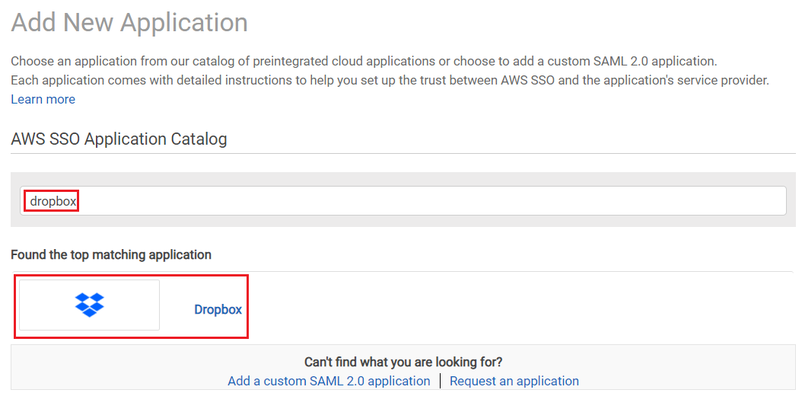
Single Sign-On Service
Add Dropbox to SSO User
View instructions

Slide 14
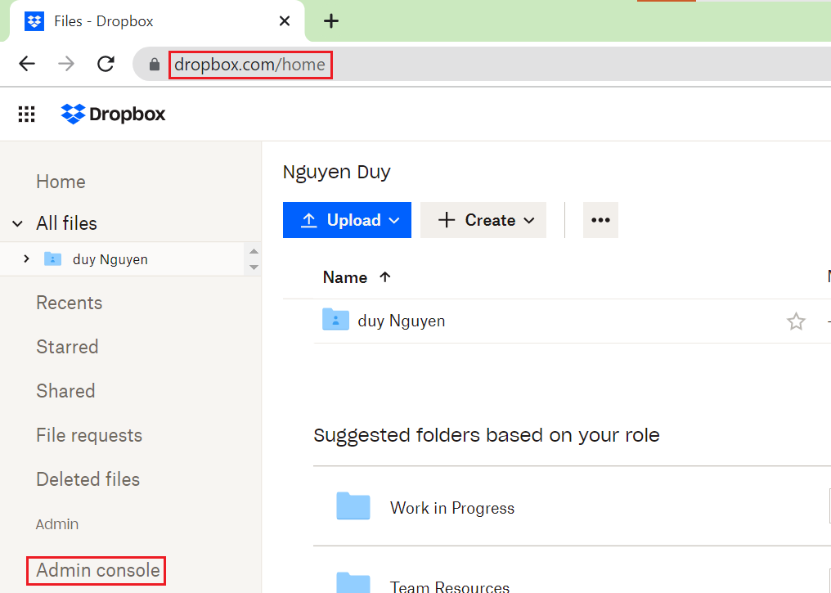
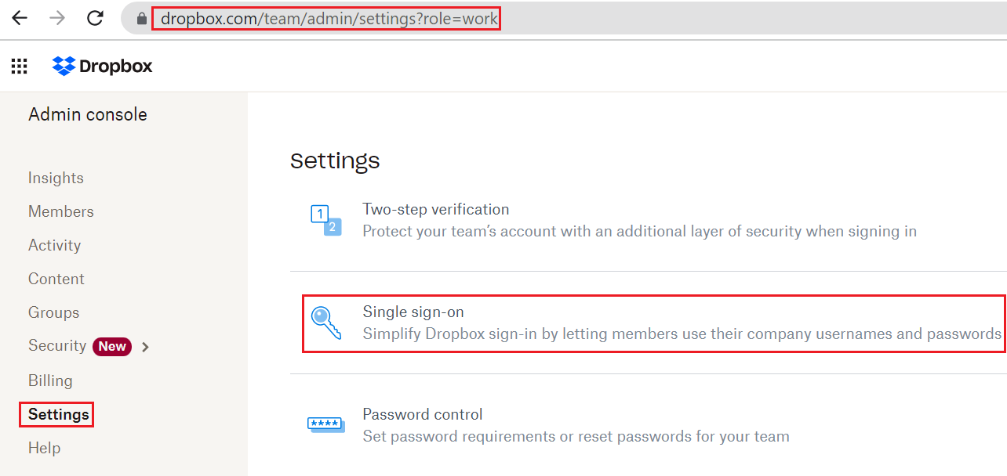
Single Sign-On Service
Only Advanced Plan support SSO

Slide 15
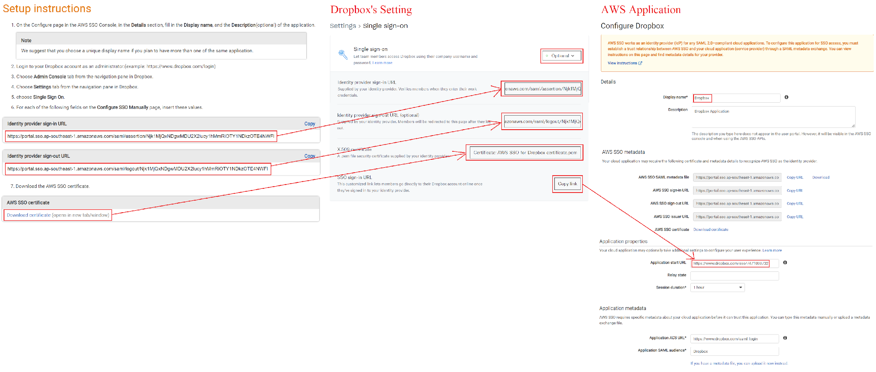
Single Sign-On Service
Create AWS SSO Application & Config Dropbox SSO

Slide 16
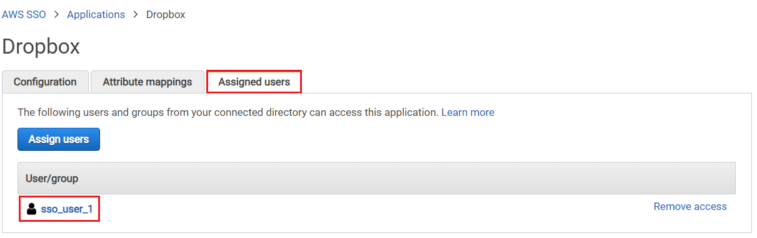
Single Sign-On Service
Add Dropbox Application to SSO User

Slide 17
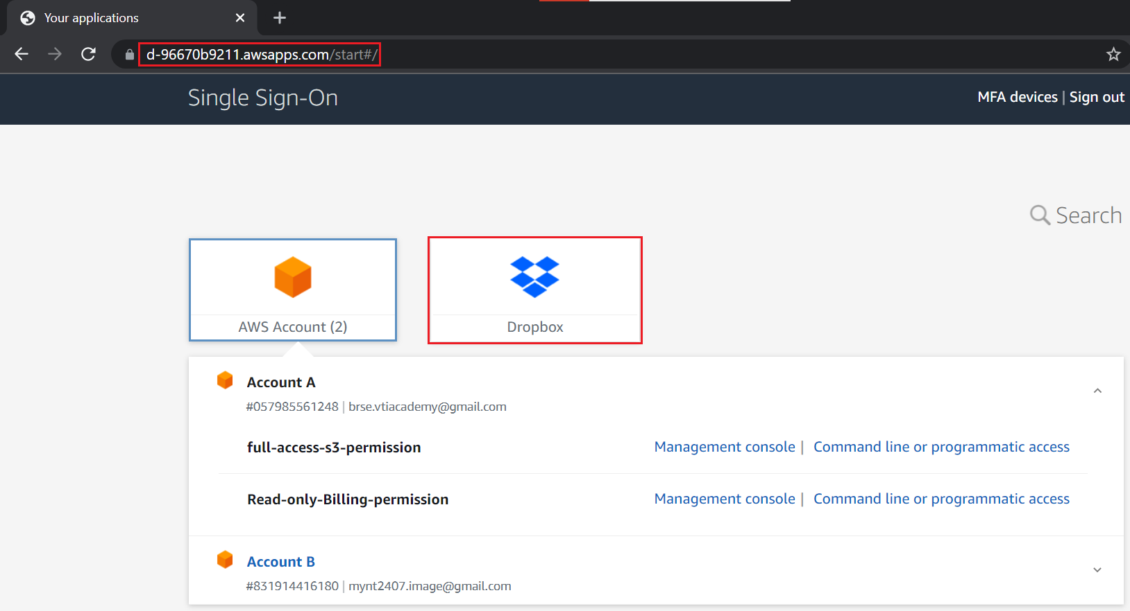
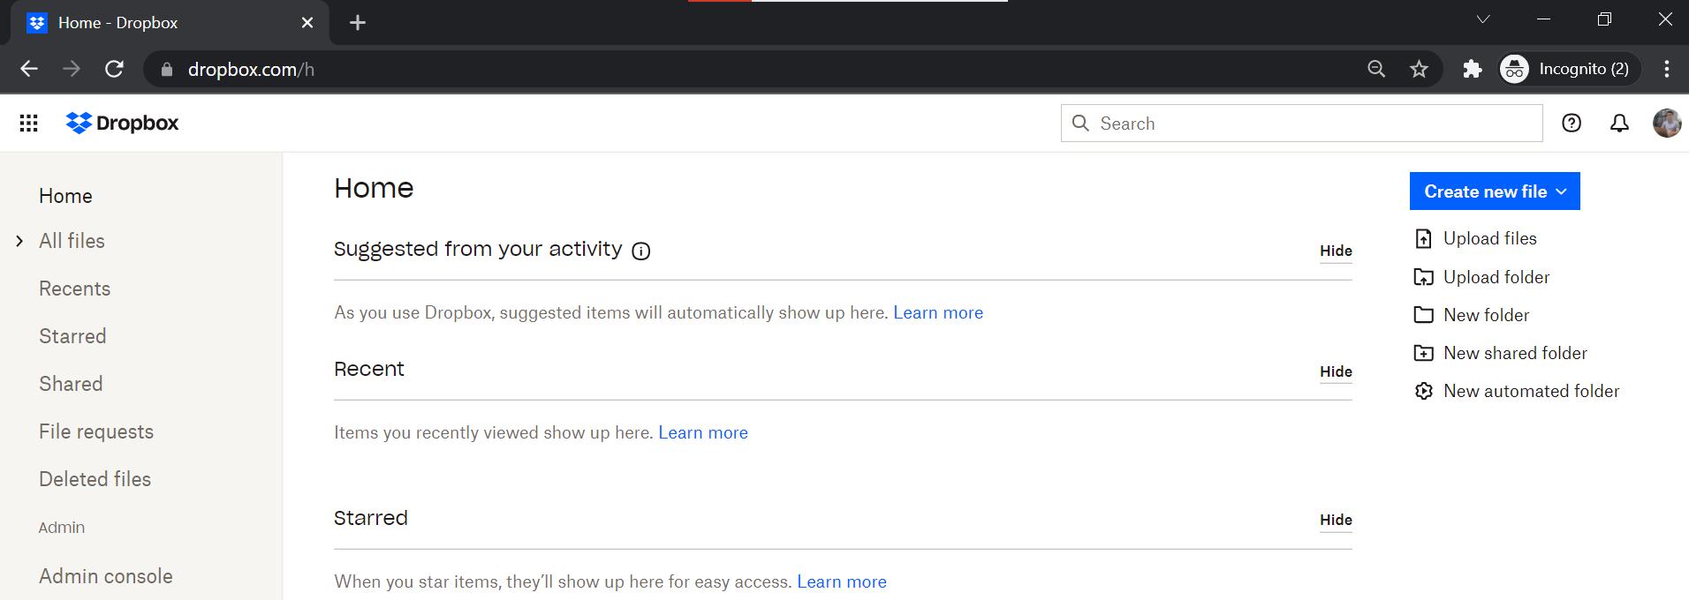
Single Sign-On Service
Test

Slide 18
Single Sign-On Service
Other Demo
G Suite: https://www.youtube.com/watch?v=gxqP9L40Sko
On-Premise Active Directory: https://www.youtube.com/watch?v=nuPjljOVZmU
Custom SAML Application: https://www.youtube.com/watch?v=NVHWejw6MYY
https://aws.amazon.com/blogs/security/introducing-aws-single-sign-on
https://www.youtube.com/watch?v=fV_bO_FM0pE

Slide 19
Assignment
Self-practice

Slide 20
Single Sign-On Service
Components
SSO User / Group
AWS Account
Application
Identity source

Slide 21
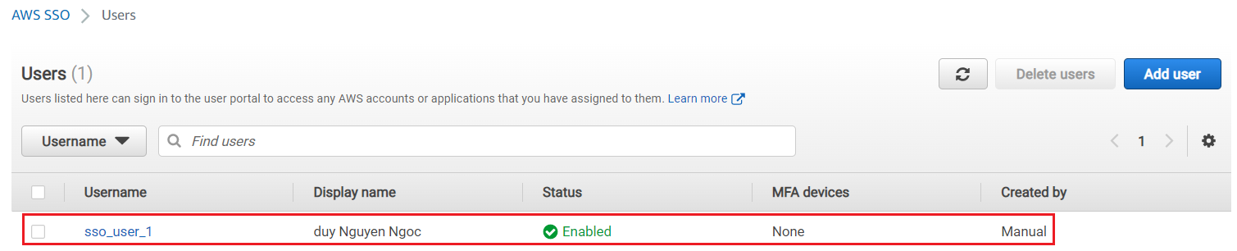
Single Sign-On Service
SSO User / Group
Is users used to login into SSO
Support group, not support nested group

Slide 22
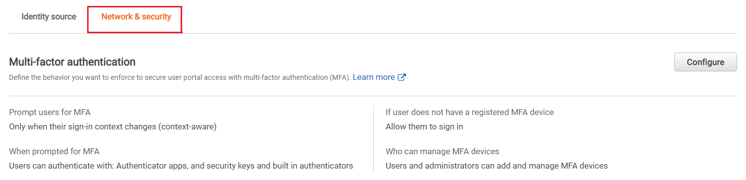
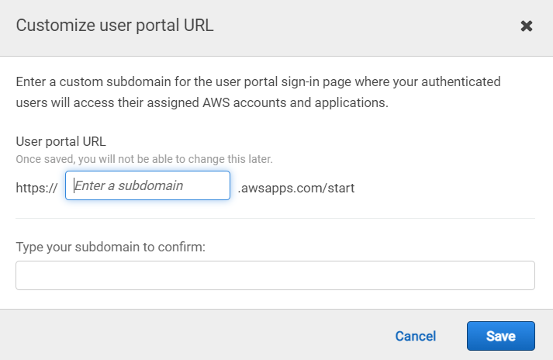
Single Sign-On Service
Each user is assigned to
AWS Accounts, 3rd-party application’s accounts
Permission sets
Support MFA for sign-in
User portal
MFA
You can change User Portal URL

Slide 23
Single Sign-On Service
AWS Account
Support Account in Organization Service
Not support IAM Service

Slide 24
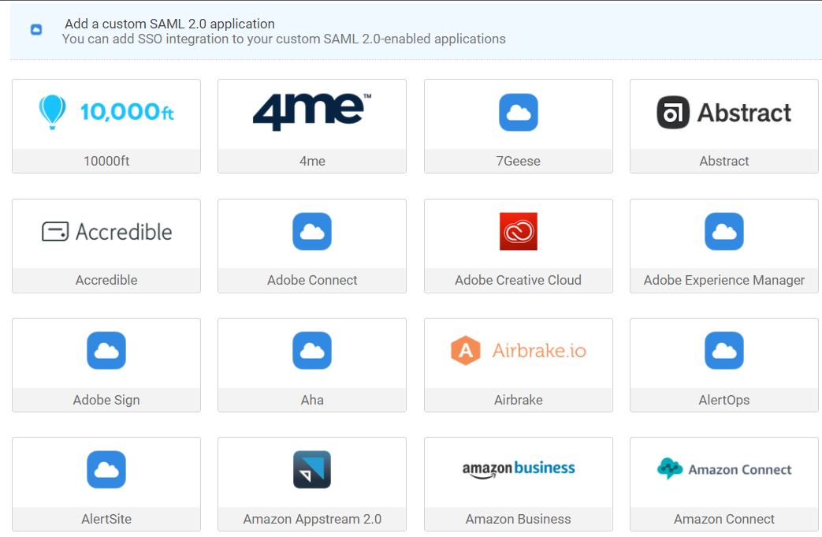
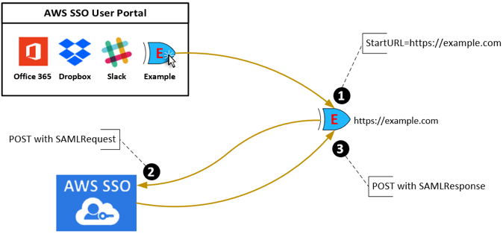
Single Sign-On Service
Application
Example
3rd-party application: Dropbox, G Suite, Jenkins, Slack, Chatwork, ...
Custom SAML Application
Including:
SSO metadata: Sign-in URL, Sign-out URL, SSO Certificate
Application Properties: Application start URL, Session duration
Applications
Flow

Slide 25
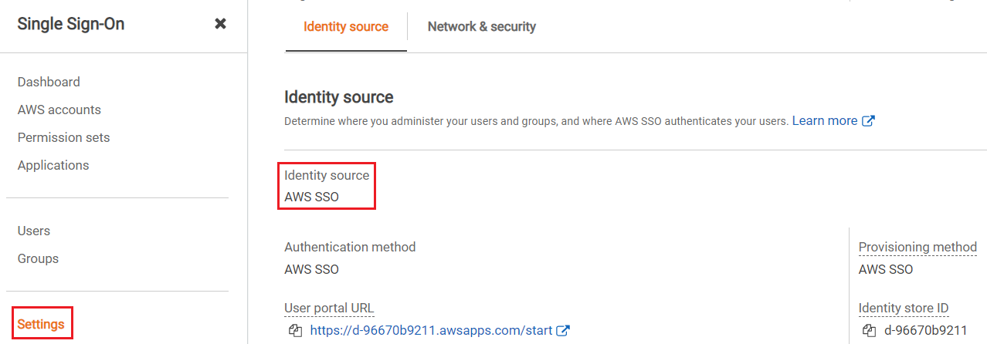
Single Sign-On Service
Identity source
A place to SSO manage and authenticate users, groups, credentials, multi-factor authentication
3 types: AWS SSO identity store (default), Active Directory (AD), External identity provider

Slide 26
Single Sign-On Service
AWS SSO identity store (default)
AWS provide users, groups, credentials, multi-factor authentication
User will login through AWS SSO User Portal

Slide 27
Single Sign-On Service
Active Directory (AD)
Manage on-premises users through AWS Managed Microsoft AD
User will login through AWS SSO User Portal

Slide 28
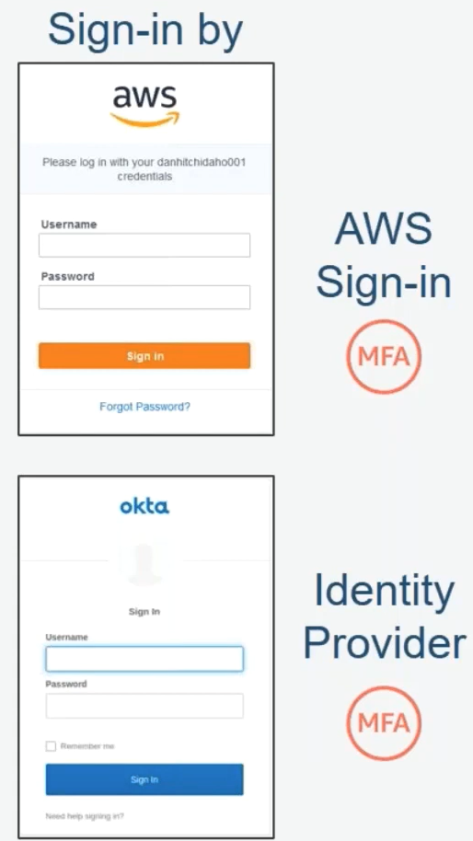
Single Sign-On Service
External identity provider
Using for Custom SAML identity provider (IdP)
User will login through IdP sign-in page
IdP sign-in page
Tutorial: https://www.youtube.com/watch?v=3CJsAVVz49o

Slide 29
Assignment
Self-practice

Slide 30
Summary
Centrally manage Single Sign-On to access multiple AWS Accounts & 3rd-party applications
Integrated with AWS Organizations, on-premises Active Directory
Centralized permission management, auditing with CloudTrail
Global Service, Price: Free
Components
SSO User / Group: support MFA for sign-in, not support nested group
AWS Account: Support Account in Organization Service, Not Support IAM User
Application: 3rd-party application: Dropbox, G Suite, Jenkins, Slack, Chatwork, ..., Custom SAML Application

Slide 31
Summary
Identity source: AWS SSO identity store, Active Directory (AD), External identity provider

Slide 32
Q & A
Copyright © VTI Academy All Rights Reserved

